Slide 1
What is a flowchart?
A flowchart is a diagram that depicts a process, system or computer algorithm. They are widely used in multiple fields to document, study, plan, improve and communicate often complex processes in clear, easy-to-understand diagrams. Flowcharts, sometimes spelled as flow charts, use rectangles, ovals, diamonds and potentially numerous other shapes to define the type of step, along with connecting arrows to define flow and sequence. They can range from simple, hand-drawn charts to comprehensive computer-drawn diagrams depicting multiple steps and routes. If we consider all the various forms of flowcharts, they are one of the most common diagrams on the planet, used by both technical and non-technical people in numerous fields. Flowcharts are sometimes called by more specialized names such as Process Flowchart, Process Map, Functional Flowchart, Business Process Mapping, Business Process Modeling and Notation (BPMN), or Process Flow Diagram (PFD). They are related to other popular diagrams, such as Data Flow Diagrams (DFDs) and Unified Modeling Language (UML) Activity Diagrams.

Slide 2
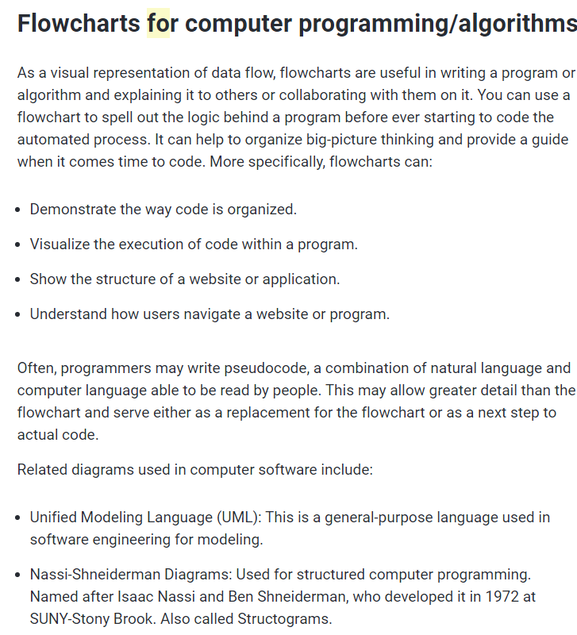

Slide 3
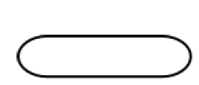


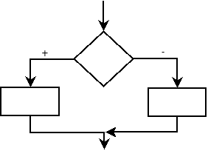
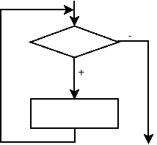
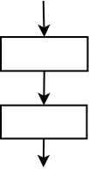
Algorithm start-end block
Data input-output block
Arithmetic block
Linear process
Branching process
Cyclic process

Slide 4
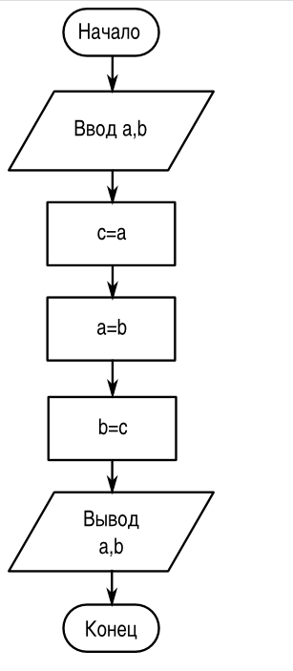
Block diagram of the value exchange algorithm

Slide 5
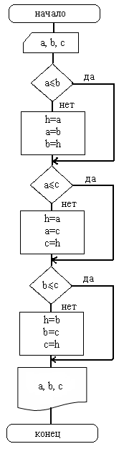
Order the three numbers a, b, c in ascending order so that variable a corresponds to the smallest number, b to the average, and c to the largest.

Slide 6
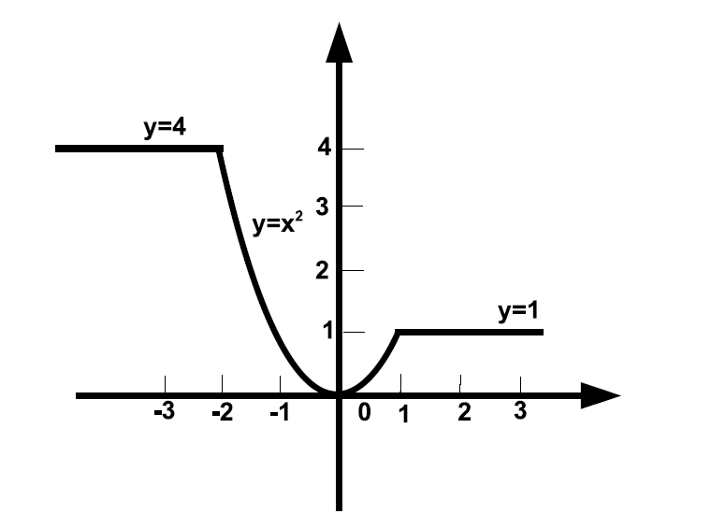
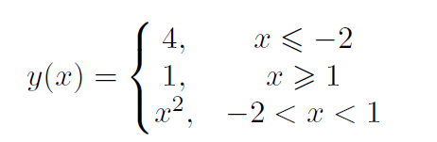
The real number x is given to us. The figure shows a graph of the function. We need to calculate y = f(x).

Slide 7
